Slide 1
Intel IC 8253 Timer
A Programmable Interval Timer
(PIT)

Slide 2
Introduction

Slide 3
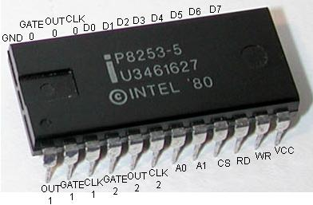
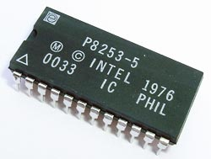
How it looks

Slide 4
Intel 8253
As the name suggests, it is a timer and thus performs timing and counting functions.
It uses three 16-bit counters.
It is programmable.
So, it can generate different types of delay signals & count external signals.
It can be operated only upto maximum frequency of 2.6MHz.

Slide 5
Why do we need this timer?
To introduce a pre-defined delay in 8085, we can use a delay subroutine.
The delay is achieved by decrementing a counter in a register using instructions. This is the software approach.

Slide 6
Disadvantage of Software Approach
Processor is locked in delay loop.
Valuable processor time is lost in counting.
How to overcome this?
By using hardware timer
Interrupts
Intel 555 can generate timing signals only at fixed time intervals. It cannot be interfaced with the microprocessor.
Hence, Intel developed PITs like 8253 and 8254.

Slide 7
FEATURES OF IC 8253
Generation of accurate time delay
3 independent 16-bit counters (a.k.a. channels)
6 programmable modes
Timer/Counter operation
Counting in BCD
Can interrupt the processor
+5V power supply
Can operate in both DC and AC

Slide 8
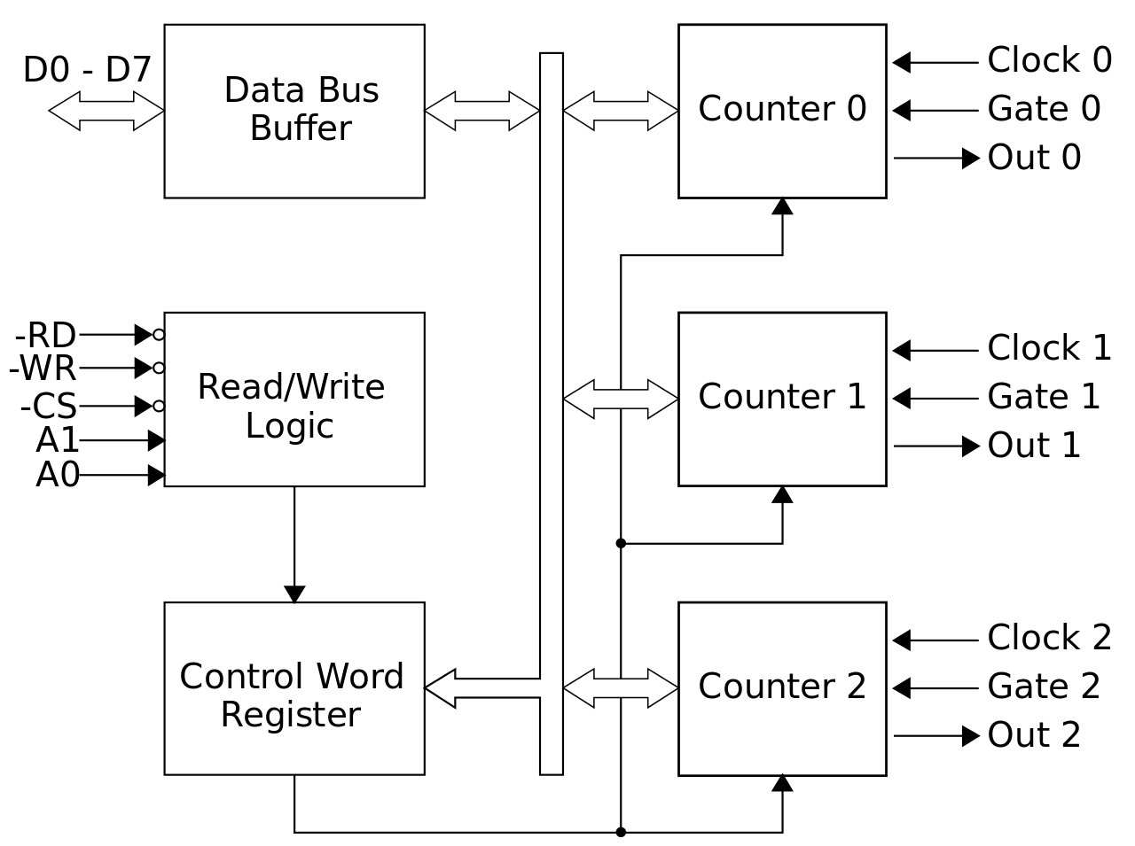
Block Diagram of 8253

Slide 9
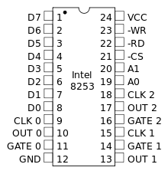
PIN Diagram

Slide 10
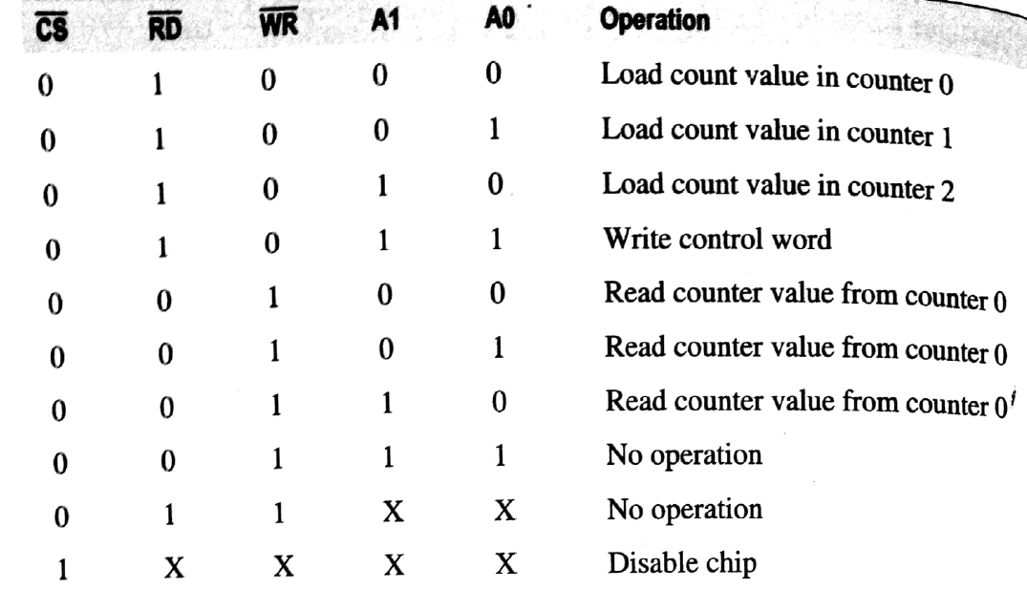
Control Signals & Operation in 8253

Slide 11
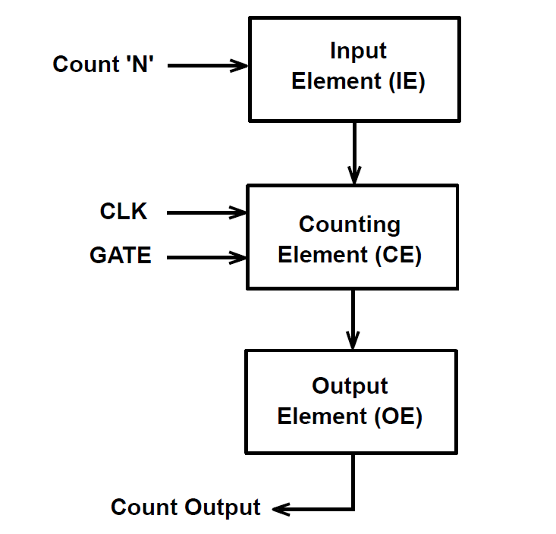
Internal Structure of Timer

Slide 12
Intel IC 8253
Working

Slide 13
Working of 8253
It is programmed by the systems software by the programmer.
8253 is configured to match requirements of programmer, who sends a set of control words to initialize the IC.
The control words program the mode, loading sequence & counting of BCD.
Programmer initializes one of the counters with desired value.
With appropriate command 8253 counts the delay and interrupts the CPU.

Slide 14
Steps in Software Control of 8253
There are basically 4 main steps:
Write control word in control register for each counter.
Write initial count value.
Apply clock pulses to the counter.
Check for desired count value & interrupt signal from the counter.

Slide 15
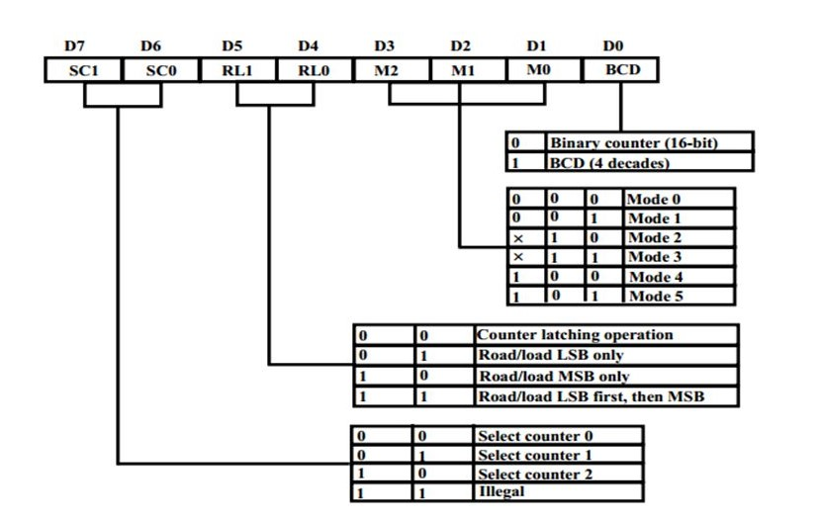
8253 Control Word Format

Slide 16
The Operating Modes

Slide 17
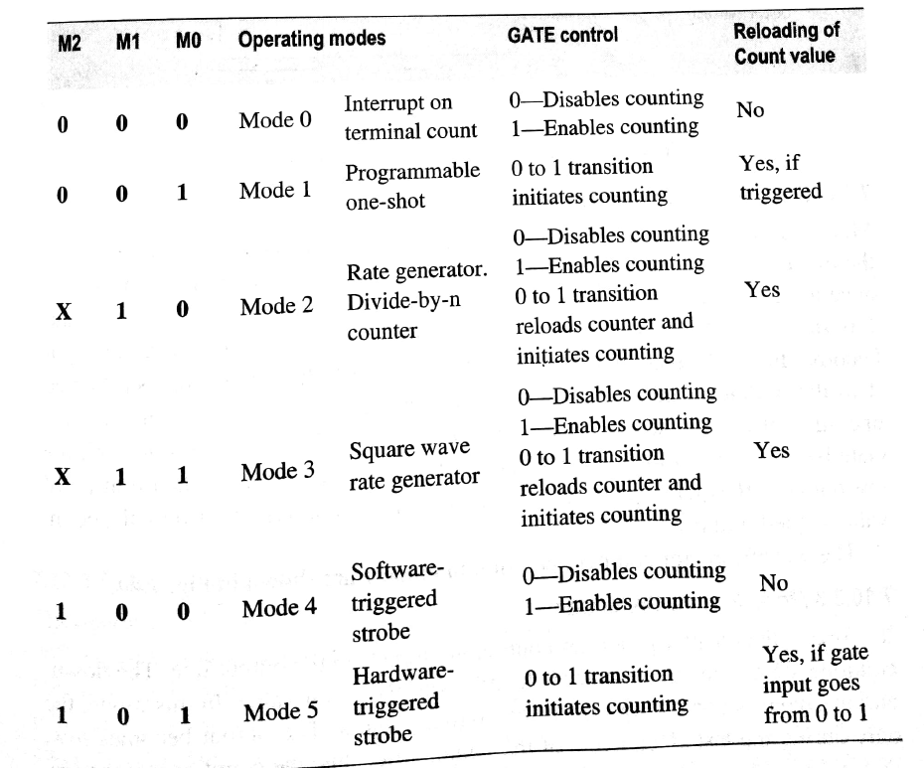
8253 Operating Modes

Slide 18
The Operating Modes of 8253(detailed)
There are 6 operating modes of 8253:
Mode 0
Mode 1
Mode 2
Mode 3
Mode 4
Mode 5

Slide 19
The Operating Modes
Mode 0

Slide 20
Mode 0: Interrupt on Terminal Count
Counter used to issue an output after counting upto pre-initialized value.
Initial count value(loaded in counter) is decremented every clock pulse.
GATE input signal also controls counting.
It is a one-time operation & OUT signal indicates termination condition.
The GATE input signal of given counter enables/disables the counting operation.

Slide 21
Mode 0: (contd.)
Set Output Bit when timer done.
The output will start off zero. The count is
loaded and the timer will start to count down.
When the count has reached zero the output
will be set high, and remain high until the next
count has been reloaded.

Slide 22
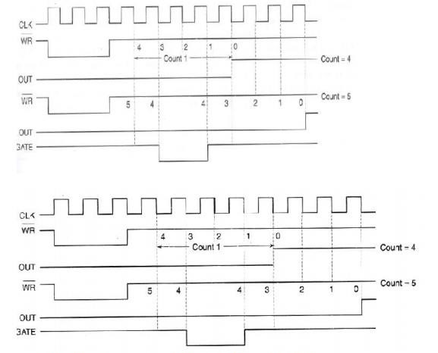
Waveforms in Mode 0

Slide 23
The Operating Modes
Mode 1

Slide 24
Mode 1: Hardware Triggered One-Shot
GATE input high triggers counting.
The count value is reloaded if in the middle of the count, the GATE goes low and becomes high again.
This behaviour is similar to a monostable multivibrator where GATE input signal acts as input.
Mode 1 is similar to Mode 0 in the fact that output becomes low while counting down & becomes high once count value reaches zero(0).

Slide 25
Mode 1: (contd.)
The output will go low following the rising edge of the GATE input. The counter will count and the output will go high once the counter has reached zero.

Slide 26
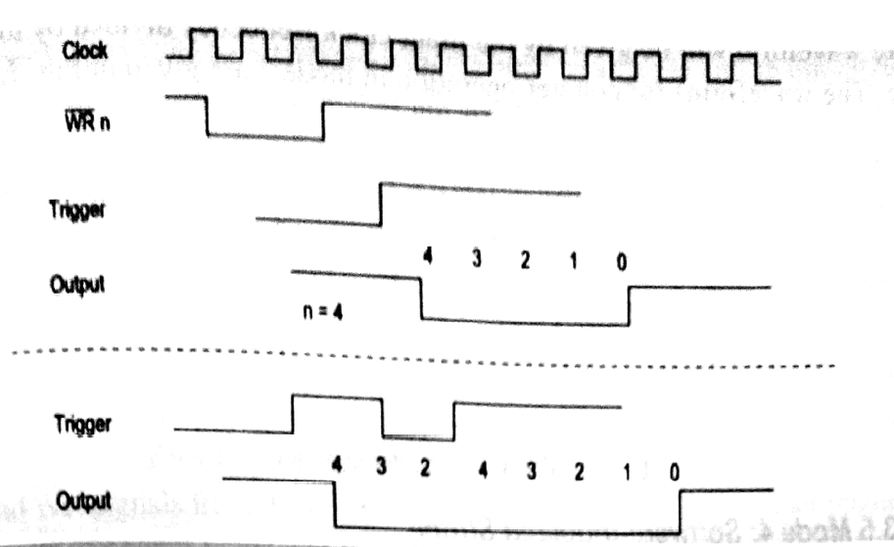
Waveforms in Mode 1

Slide 27
The Operating Modes
Mode 2

Slide 28
Mode 2: Rate Generator
Counter generates continuous signals in output line.
Counting down starts once counter is loaded with count value.
Output signal becomes high once counting starts & becomes low only during last clock cycle of the count. After this, it becomes zero(0).
The count value is then reloaded & decremented every clock pulse.

Slide 29
Mode 2 :(contd.)
Why is it called Rate Generator?
The counter will continually count down, when the count reaches zero, the output will pulse low and the counter will be reloaded.
As only one low pulse is generated during the entire count cycle, this mode is called the rate generator or frequency divider.

Slide 30
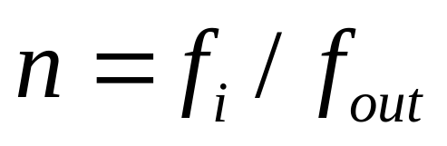


Mode 2 :(contd.)
The divided output frequency is given by:
where,
n = value to be loaded
= input clock frequency
= output clock frequency

Slide 31
Mode 2 :(contd.)
This mode is commonly used to generate a real-time clock interrupt.
The output can be used to interrupt the processor during every output period of the counter.
The GATE input acts as RESET input. If it becomes 0, counting is disabled. When it is 1, the count value is reloaded & counting starts again.

Slide 32
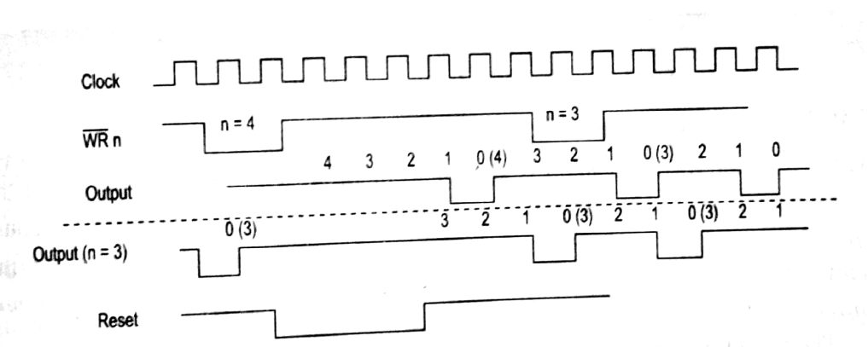
Waveforms in Mode 2

Slide 33
The Operating Modes
Mode 3

Slide 34
Mode 3: Square Wave Generator
It is similar to mode 2.
Only difference is that output is a square wave with equal low and high periods.
The output remains low for half of the timer period and high for the other half of the period.
If the count is odd, the output will be high for (n+1)/2 clock periods & low for (n-1)/2 clock periods.

Slide 35
Mode 3:(contd.)
The count value is re-initialized once count value reaches zero(0).
Thus, square wave is continuously generated.
The output frequency is given by:
= (Input freq. / Count value)

Slide 36
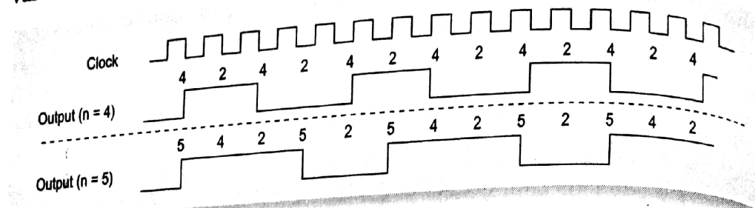
Waveforms for Mode 3

Slide 37
The Operating Modes
Mode 4

Slide 38
Mode 4: Software-triggered Strobe(Pulse)
The down-counting is initiated by writing count value in the counter.
Hence, software-triggered.
The output is low during last clock period of every count cycle.
GATE input controls the counting & re-initializes the count value.
Input of 0 on GATE input pin inhibits counting.

Slide 39
Mode 4: (contd.)
Basically, what happens is that :
The output remains high untill the timer has counted to zero, at which point the output pulse becomes low and then goes high again.

Slide 40
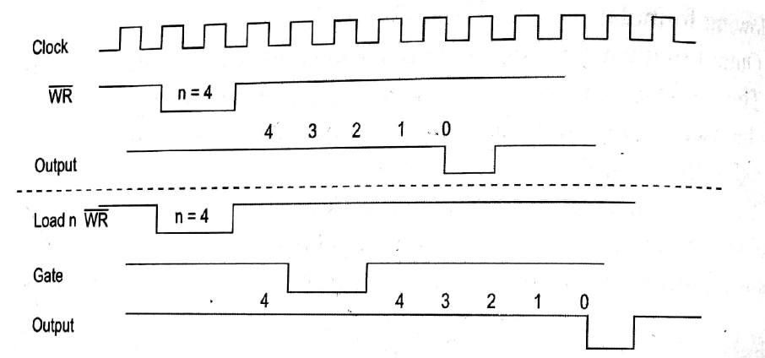
Waveforms for Mode 4

Slide 41
The Operating Modes
Mode 5

Slide 42
Mode 5: Hardware-triggered Strobe(Pulse)
It is similar to mode 4. Only difference is the triggering of counting, which is done by the GATE input signal.
Hence, it is hardware-triggered.
The output is high once the count value is loaded.
Counting starts on rising-edge of GATE pulse.
Output is low during last count.

Slide 43
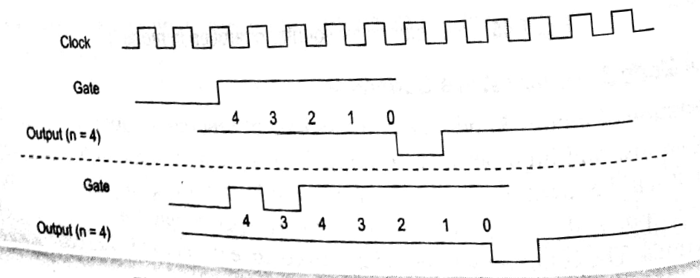
Waveforms for Mode 5

Slide 44
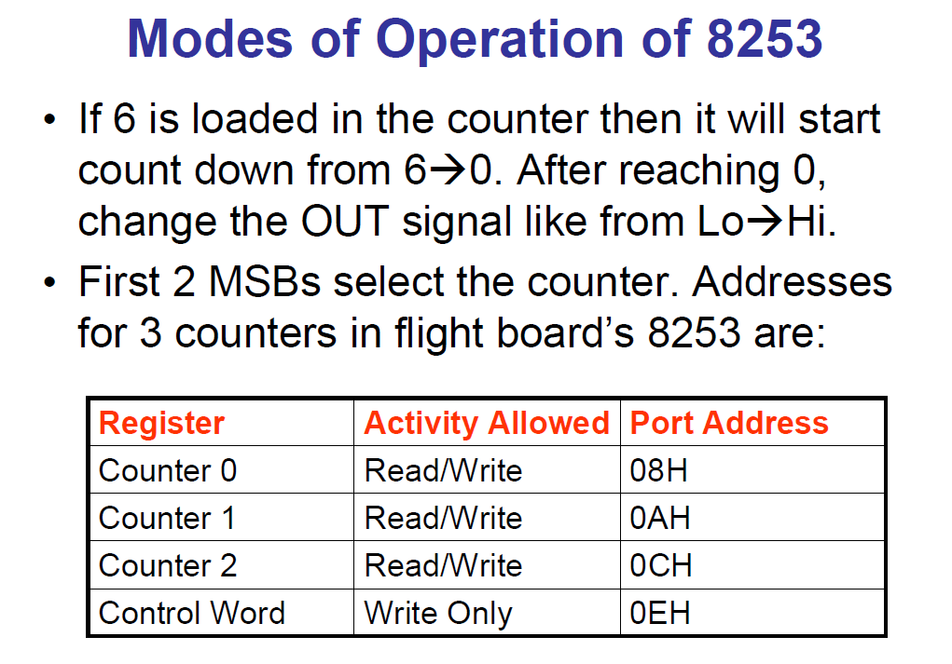

Slide 45
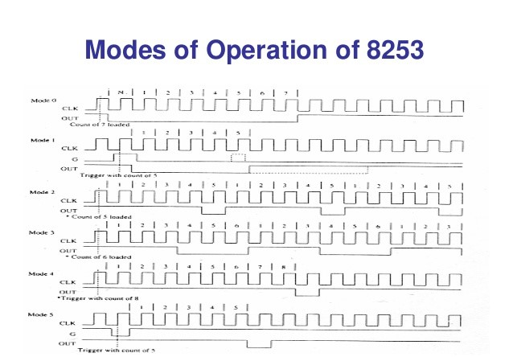

Slide 46
Conclusion

Slide 47
Why study 8253?
REASONS :
Intel micro-computer requires timing & counting operations.
8253 is specially designed for it.
The timing & counting operations can be implemented using software as well as hardware.
It's in our syllabus !!!!!!!!!

Slide 48

Let us take an Example :
Q) Let in an application, microprocessor is required to execute N different tasks and these tasks are to be executed at an interval of T seconds.
What can be the possible solutions??

Slide 49
The Software Solution
We call a delay routine of T seconds after a task (say 'i') is completed and then do next task (say 'j').
In a software delay subroutine, either a register/register pair is initialized & decremented continuously till it becomes zero.
Now to maintain the precision of the delay, it won't be possible for the microprocessor to execute any other task during this interval.
If there are more such tasks, then microprocessor will be busy most of the time to execute the delay routines.
If microprocessor has to perform some other useful task during (calculation), which is common in control applications, then it is very difficult.

Slide 50
The Hardware Solution
The H/W solution : Use an external timer.
The micro-computer may start this timer with a programmable value after executing the task 'i', then μC is free to do something else.
This external timer maybe down counter or up counter.
The external timer after a delay of T seconds interrupts the μP. The μC executes task 'j' once it gets this interrupt.
This is what we call a programmable timer.
Hence, the need to study such timers like 8253.

Slide 51
In a Nutshell
What we learnt so far about Intel IC 8253?
It's a programmable counter/timer chip designed for use as Intel μC peripheral.
It consists of three identical 16-bit counters.
The maximum clock input to the timer is 2.6 MHz.
There are 6 operating modes(Mode 0 - 5).
Each counter may be programmed to operator in one of the six modes, independent of the mode of operation of the other two timers.

Slide 52


Slide 53
Our Sources
https://en.wikipedia.org/wiki/Intel_8253
https://www.tutorialspoint.com/microprocessor/microprocessor_intel_8253_8254_operational_modes.htm
https://nptel.ac.in/courses/108107029/module10/lecture54.pdf
https://www.wisdomjobs.com/e-university/microprocessor-tutorial-2391/intel-8253-programmable-interval-timer-25965.html

